Slide 1

TechnoBabel

Slide 2
Overview
Project Objective
Team Roles
Client Contact Information
Potential Tech Stack

Slide 3
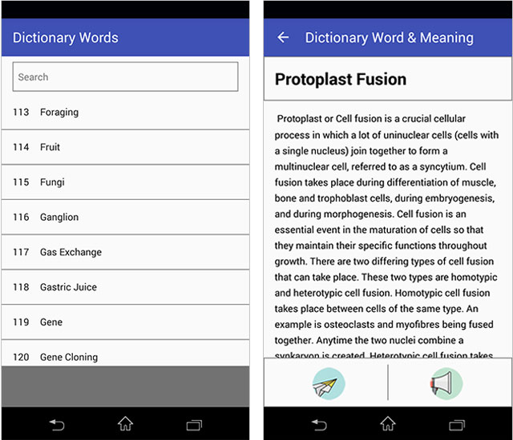
Project Introduction
TechnoBabel is a mobile app that serves as a dictionary for company employees.
Employees will have the ability to add and edit company terminology.

Slide 4

Team Roles
Team Lead: Chris You
Front-End Lead: Bryan Robinson
Back-End Lead: Keith Zane
QA Lead: Bryan Robinson
Presentation Lead: Justin Stryjewski
Documentation Lead: Chris You

Slide 5

Client Contact Information
Client: Deric Cunningham
Client Meeting: Thursday, September 14th, 2017
Plans to set up reoccurring meetings

Slide 6
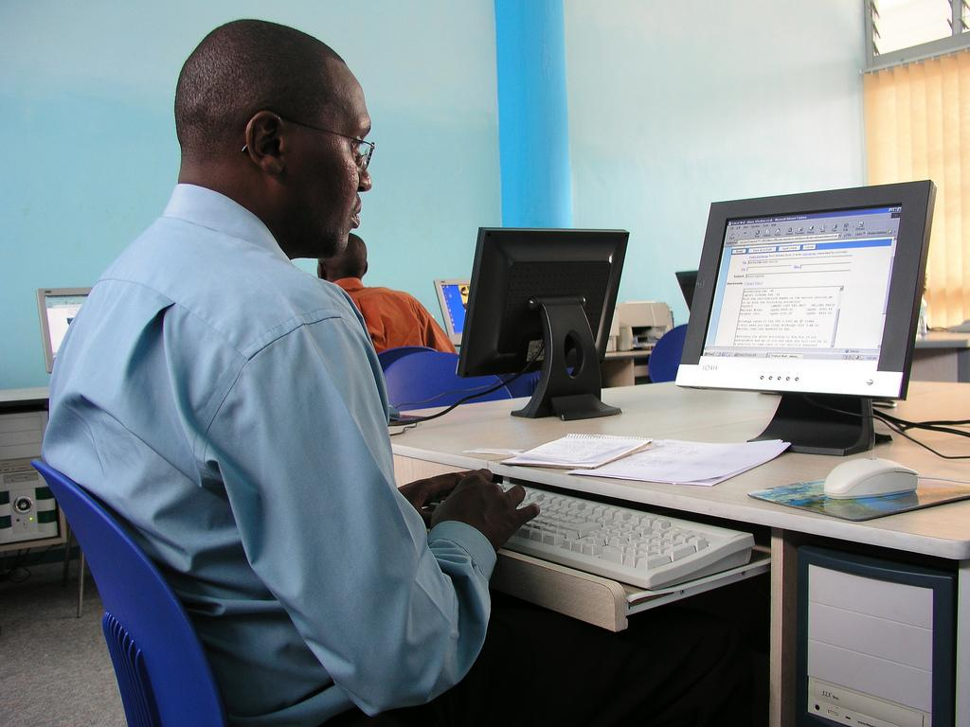
Possible Tech Stack
Frontend development
Ionic frameworks (html/css/js)
Backend development (possible)
Node.js
Microsoft Azure
Webstorm IDE
JavaScript

